Slide 1
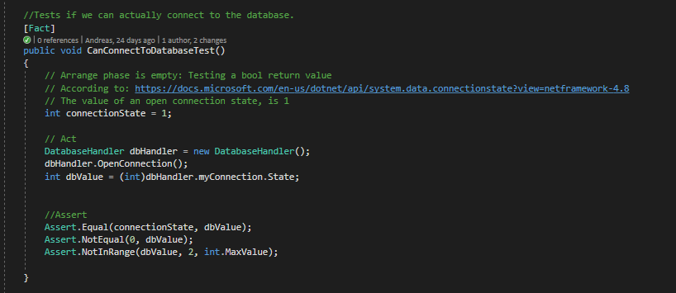
Functional Testing
Unit Testing
Integration Testing
Multiple parts of the system
Multiple units
Database

Slide 2
Functional Testing
System Testing
Interface Testing
Regression Testing
User Acceptance Testing

